Slide 1
Living Faith

Slide 2
What does it look like to live by faith in God’s Word?

Slide 3
You get God’s heart
of love for others!

Slide 4
You get a vision for marriage that’s based on God’s relationship with you!

Slide 5
YOU RECOGNIZE THAT GOD HAS MADE YOU BE ACCOUNTABLE IN HIS LOCAL CHURCH STRUCTURE.
You submit to biblical authority.

Slide 6
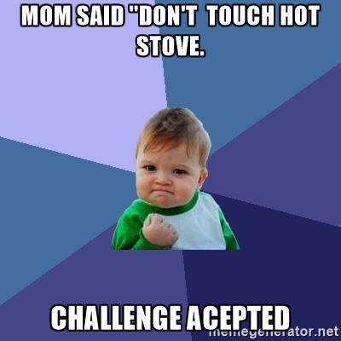
BY FAITH
SUBMIT TO FAITHFUL PASTORS.
KEY: Spiritually immature people do not submit to biblical authority.
KEY: All authority comes from God Himself!

Slide 7
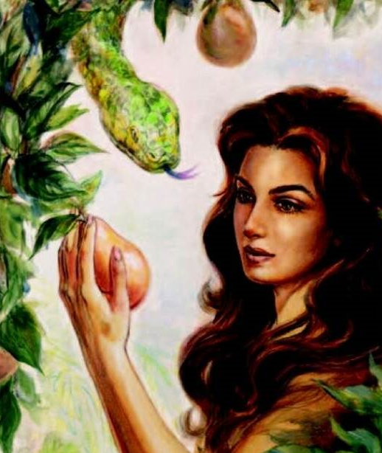
BY FAITH
WHEN GIVING THE WORD, BE CONSISTENT AND FAITHFUL
TO THE DOCTRINE YOU’VE BEEN DELIVERED.
God is consistent and faithful. Vs 8
You be consistent and faithful too! Vs 9!

Slide 8
YOU LIVE IN LIGHT OF CHRIST’S SACRIFICE.

Slide 9
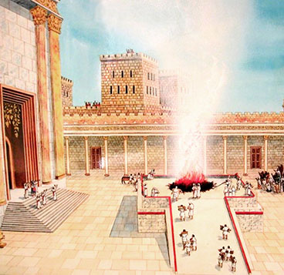
BY FAITH
THE OT SACRIFICES WERE
OFFERED UPON THE ALTAR.
THERE WERE TWO KINDS:
The sweet-savour offerings – they would become food for the priests.
The sin offerings which was burned outside the camp was not food for the priests.

Slide 10
Today, IN JESUS, we now have an altar, the sacrifice, and the Great High Priest!

Slide 11
Matt 23:19 Ye fools and blind: for whether is greater, the gift, or the altar that sanctifieth the gift?
John 17:17-19 Sanctify them through thy truth: thy word is truth. 18 As thou hast sent me into the world, even so have I also sent them into the world. 19 And for their sakes I sanctify myself, that they also might be sanctified through the truth.

Slide 12
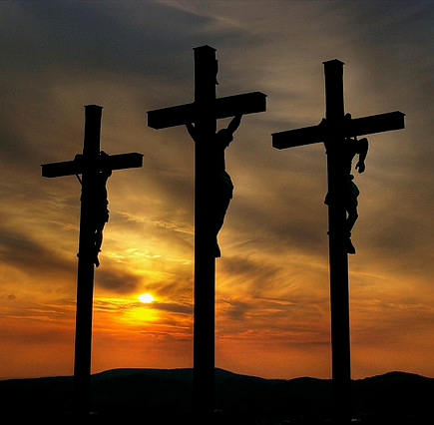
BY FAITH
WE NEED TO MEET HIM OUTSIDE THE CAMP!
Identity with Christ.
Our future is with Him in a
CITY to come: New Jerusalem

Slide 13
Phil 3:20 For our conversation is in heaven; from whence also we look for the Saviour, the Lord Jesus Christ:
Col 3:1-3 If ye then be risen with Christ, seek those things which are above, where Christ sitteth on the right hand of God. 2 Set your affection on things above, not on things on the earth. 3 For ye are dead, and your life is hid with Christ in God.
1 Pet 1:4 To an inheritance incorruptible, and undefiled, and that fadeth not away, reserved in heaven for you,

Slide 14
BY FAITH
A PURPOSE OF PRAISE TO CHRIST.
Sacrifice 2.0 – UPGRADE!

Slide 15
John 10:9 I am the door: by me if any man enter in, he shall be saved, and shall go in and out, and find pasture.
Eph 2:18 For through him we both have access by one Spirit unto the Father.

Slide 16
BY FAITH
A PURPOSE OF PRAISE TO CHRIST.
Sacrifice 2.0 – UPGRADE!
  Sacrifice of praise.
  Sacrifice of spiritual works.

Slide 17
Living Faith

